Slide 1
Astroid Shooting Game using pygame Library
Md. Afnan Ul Haque
Associate AI Engineer
Next Solution Lab

Slide 2
Outline
Game Introduction
Game Overview
Control Instructions
Winning/Loosing Method
Game Termination

Slide 3
Introduction
The Game is about Space and Asteroid.
The Astroid Comes down from the space and Spaceship fires to destroy Asteroid.
Player scores when he/she destroys each Astroid.

Slide 4
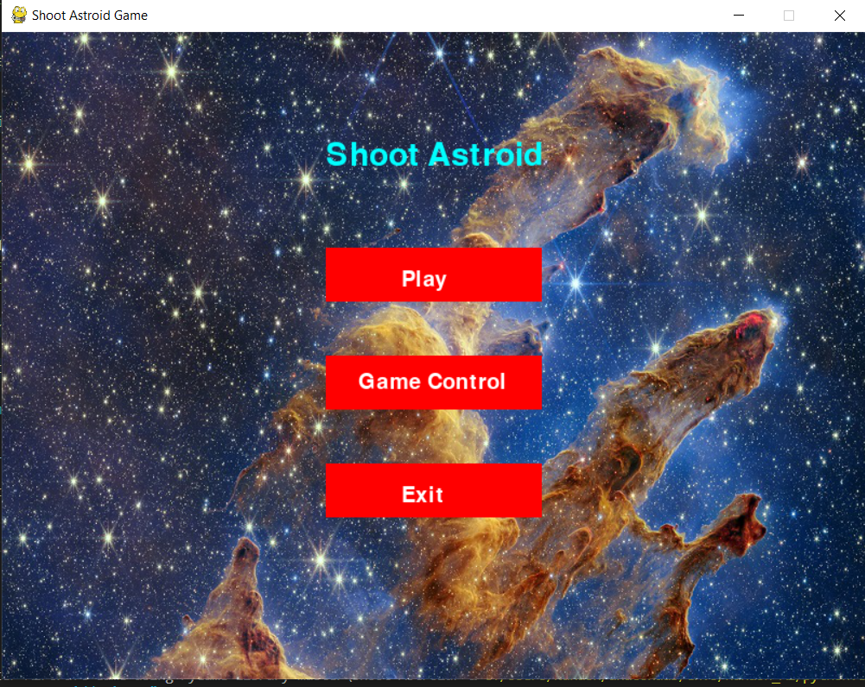
Game Overview

Slide 5
Game Overview
If Play is pressed, the game starts.
Game Control contains the instruction for game.
Exit is to Quit from game.

Slide 6
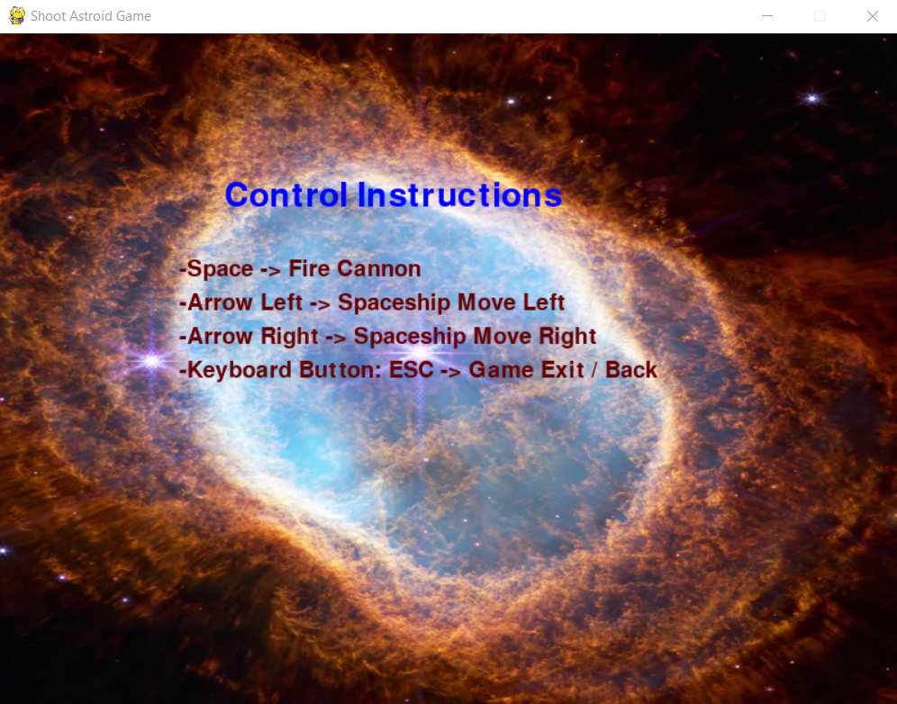
Game COntrol

Slide 7
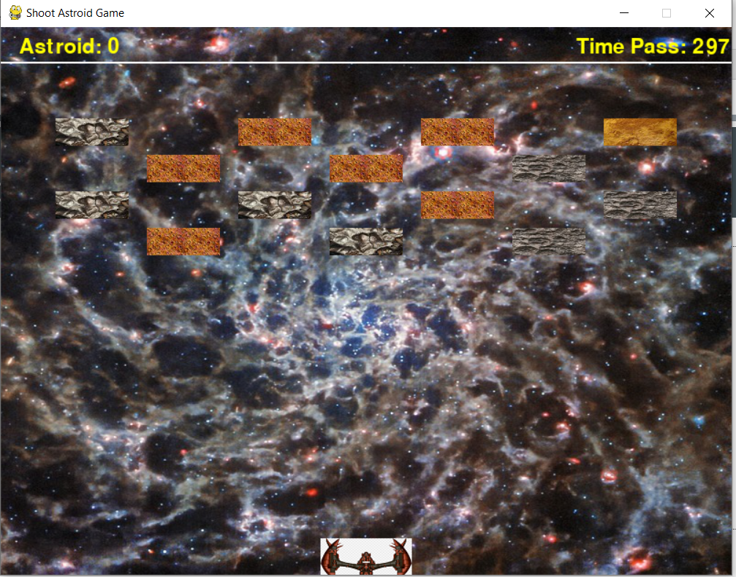
Game Overview

Slide 8
Game overview
Player has to shoot with Space and move Spacecraft in any direction.
Each time the game starts, new pattern of asteroid is designed.
With each destruction, the astroids come closer to the Spacecraft.
The Astroids moves into random direction, so be confident with the shot.

Slide 9
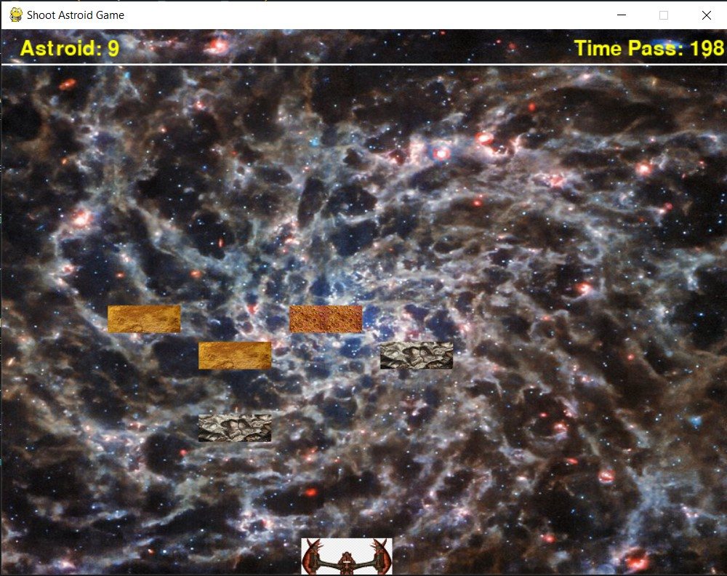
Game play

Slide 10
Winning/loosing method
Player has to shoot all the astroids before the astroids crosses the spaceship.
If player fails to shoot all the astroids, the game is lost.
If player shoots all the astroids, the game is won.

Slide 11
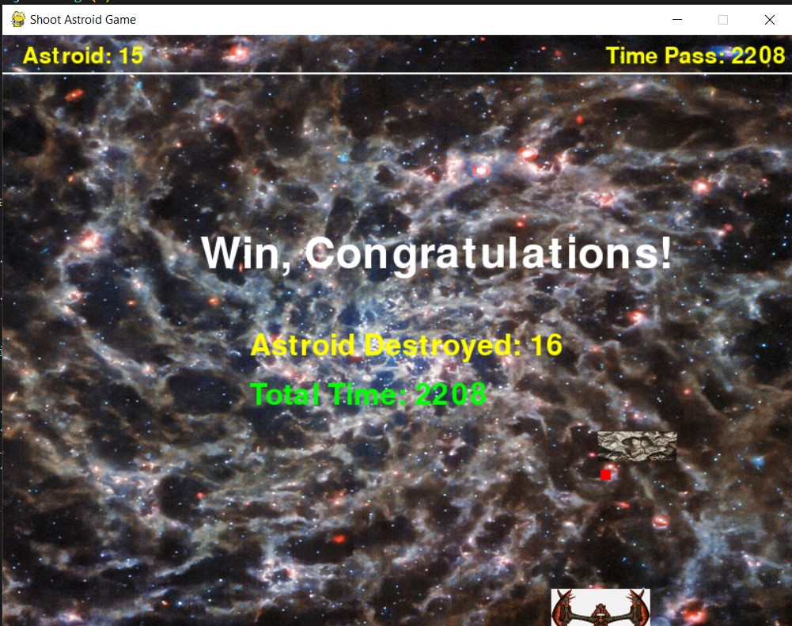
Winning/loosing method

Slide 12
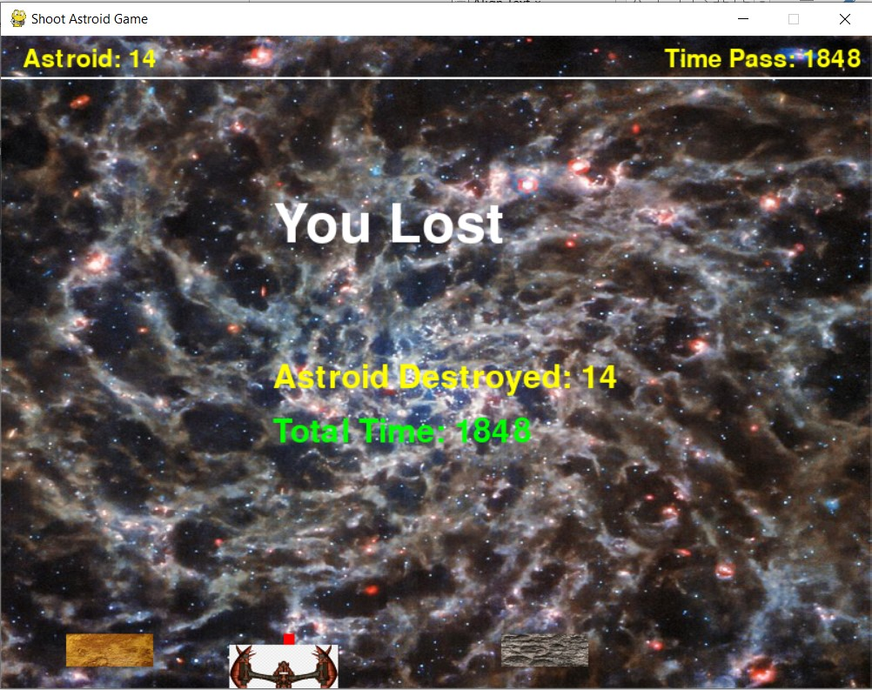
Winning/loosing method

Slide 13
Game termination
After Win / Loose, the Game is redirected to the Main Menu.
Player can exit game by Exit button.

Slide 14
Thank You!

